Slide 1

What is it ??
T means use of hardware, software, services and supporting infrastructure to manage and deliver information using voice , data and video.
It means security ,computer technical support, business software development and database and network management .

Slide 2
Type of it ??
Software
Designing
Hardware
Marketing

Slide 3
software
Software is asset of instructions , data or programs used to operate computer and execute specific tasks .
In marketing – it helpful for active campaign , 4ps – which product , price, place , promotion .
In design – act as a interface between requirements and development .
In hardware – hardware needs software to tell it what to do , but software also needs hardware in order to act out its directions.

Slide 4

Design & graphics :
Designing is about problem solving .
Software required designing and graphic to make it more attractive
Which increase user to use there website or anything else
Which leaves impression in your mind and make user to comeback to side .
Designing is helpful for communicating the user which helpful for user to see and which better than reading text .

Slide 5
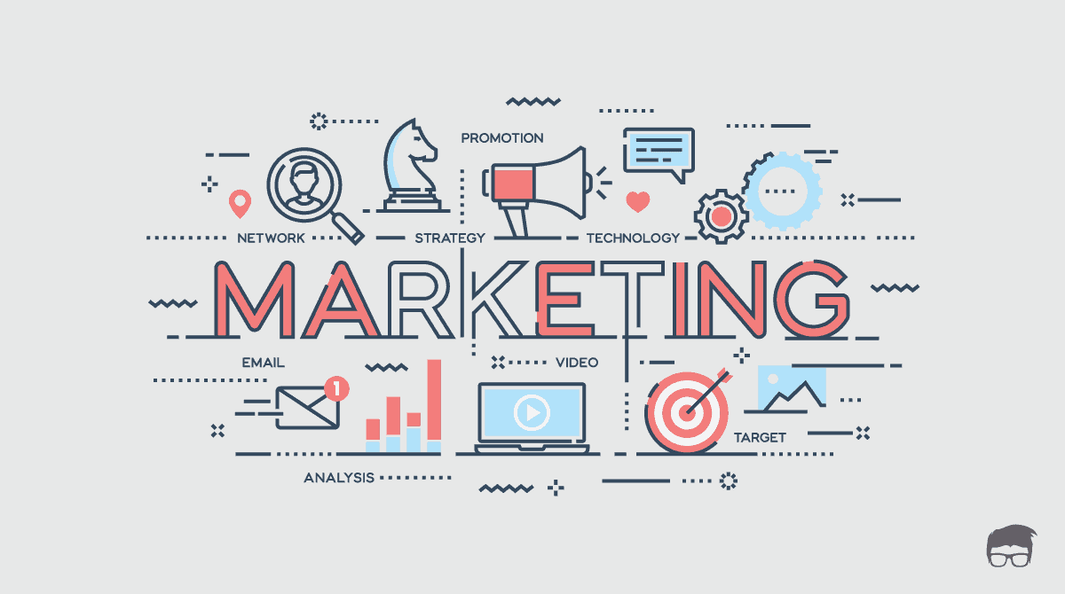
Marketing :
When software is developed and designing is work done from there marketing work start
Marketing is important component after software development and designing .
Marketing is required to spread brand awareness among user .
To increase the sales of business.

Slide 6
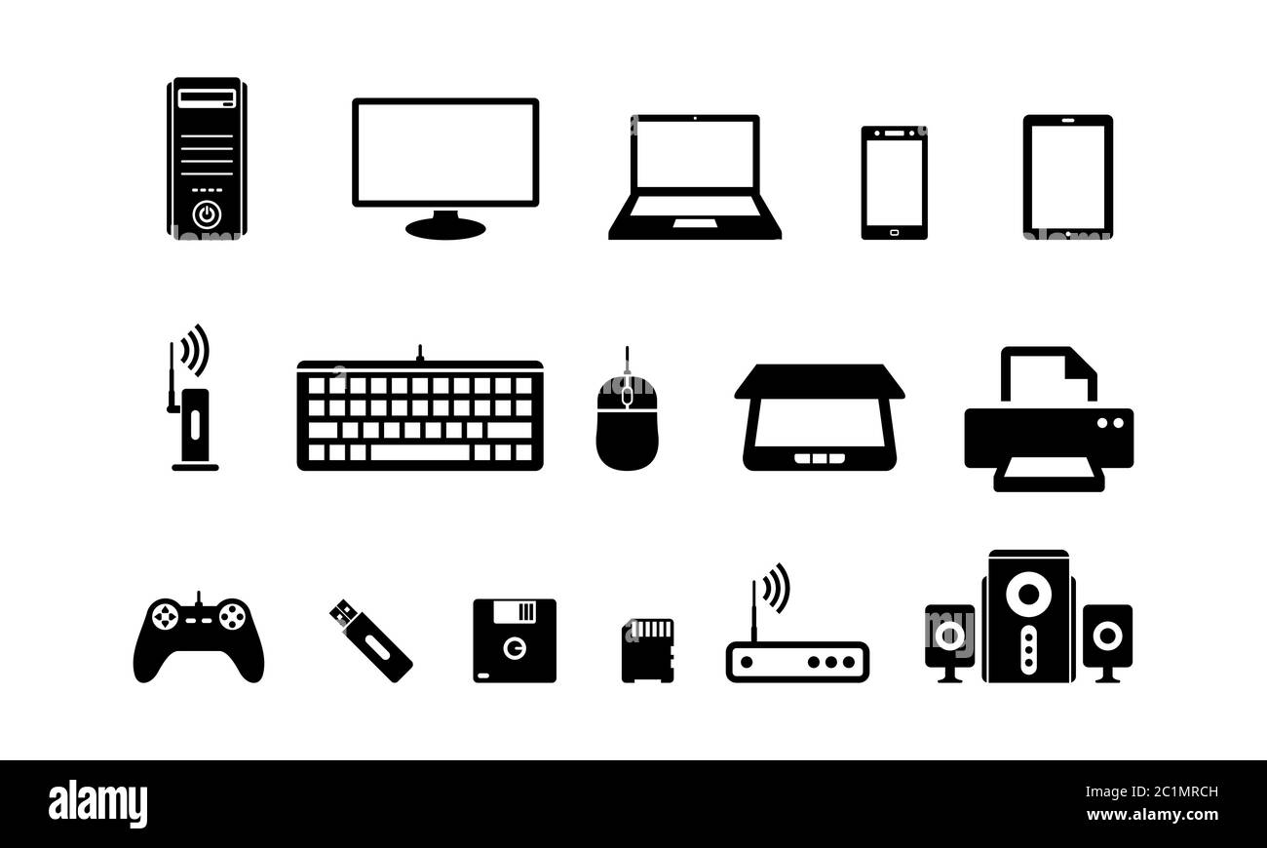
Hardware :
hardware refers to physical elements of computer .
In design – for graphic design there are two specifications that are important the name of cores and the speed of the processor
CPU directs (central processing unit) all the other computer components .
Hardware required in software which make user helpful to use .

